Slide 1

Statements – Worksheet A
The worksheet is in 2 sizes.

Slide 2
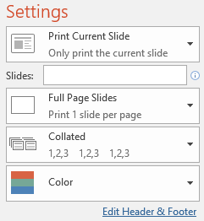
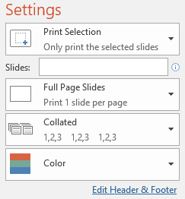
Printing
To print handouts from slides -
Select the slide from the left. Then click:
File > Print > ‘Print Current Slide’
To print multiple slides -
Click on a section title to highlight all those slides,
or press ‘Ctrl’ at the same time as selecting slides to
highlight more than one. Then click:
File > Print > ‘Print Selection’
To print double-sided handouts -
Highlight both slides before using ‘Print Selection’.
Choose ‘Print on Both Sides’ and ‘Flip on Short Edge’.

Slide 3
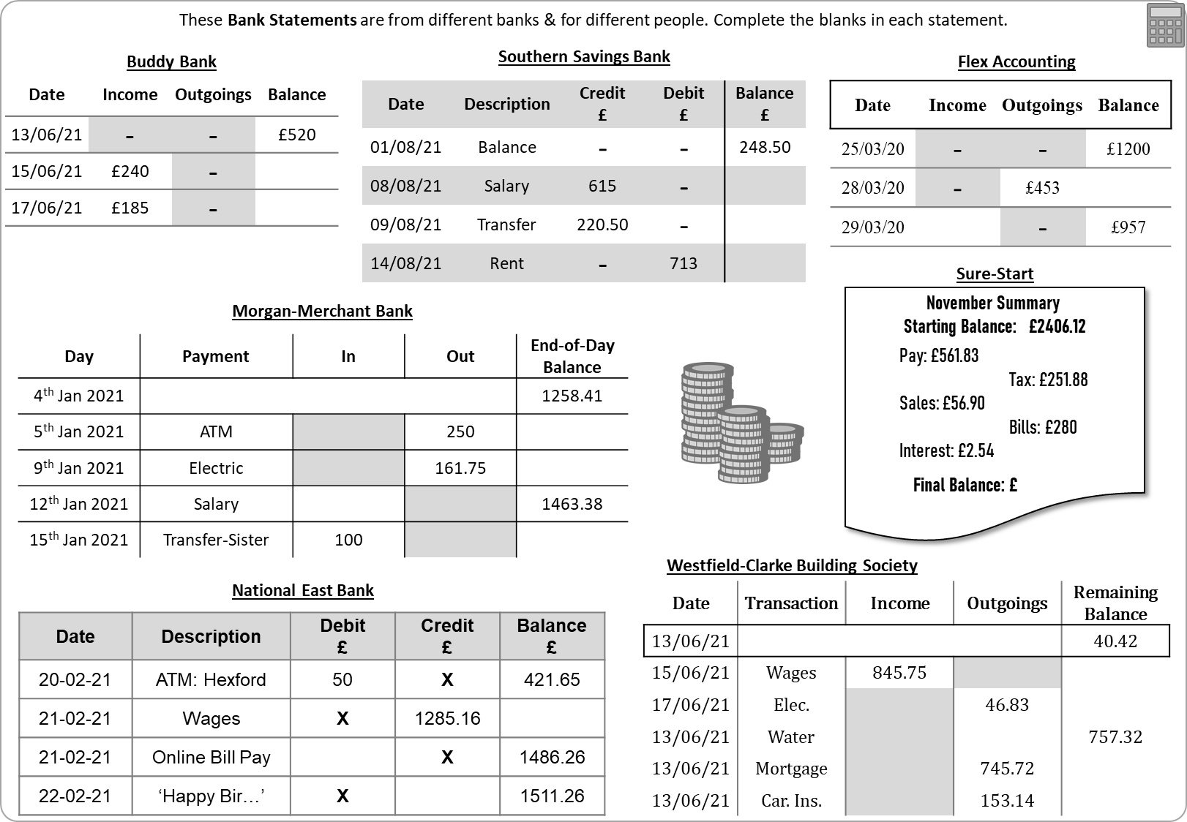

Slide 4


These Bank Statements are from different banks & for different people. Complete the blanks in each statement.
Buddy Bank
Southern Savings Bank
Flex Accounting
Date | Income | Outgoings | Balance
13/06/21 | - | - | £520
15/06/21 | £240 | -
17/06/21 | £185 | -
Date | Description | Credit £ | Debit £ | Balance £
01/08/21 | Balance | - | - | 248.50
08/08/21 | Salary | 615 | -
09/08/21 | Transfer | 220.50 | -
14/08/21 | Rent | - | 713
Date | Income | Outgoings | Balance
25/03/20 | - | - | £1200
28/03/20 | - | £453
29/03/20 |  | - | £957
Sure-Start
Morgan-Merchant Bank
November Summary
Starting Balance: £2406.12
Pay: £561.83
Tax: £251.88
Sales: £56.90
Bills: £280
Interest: £2.54
Final Balance: £2495.51
Day | Payment | In | Out | End-of-Day Balance
4th Jan 2021 |  |  |  | 1258.41
5th Jan 2021 | ATM |  | 250
9th Jan 2021 | Electric |  | 161.75
12th Jan 2021 | Salary |  |  | 1463.38
15th Jan 2021 | Transfer-Sister | 100
Westfield-Clarke Building Society
National East Bank
Date | Transaction | Income | Outgoings | Remaining Balance
13/06/21 |  |  |  | 40.42
15/06/21 | Wages | 845.75
17/06/21 | Elec. |  | 46.83
13/06/21 | Water |  |  | 757.32
13/06/21 | Mortgage |  | 745.72
13/06/21 | Car. Ins. |  | 153.14
Date | Description | Debit £ | Credit £ | Balance £
20-02-21 | ATM: Hexford | 50 | X | 421.65
21-02-21 | Wages | X | 1285.16
21-02-21 | Online Bill Pay |  | X | 1486.26
22-02-21 | ‘Happy Bir…’ | X |  | 1511.26

Slide 5
These Bank Statements are from different banks & for different people. Complete the blanks in each statement.
Buddy Bank
Southern Savings Bank
Flex Accounting
Date | Income | Outgoings | Balance
13/06/21 | - | - | £520
15/06/21 | £240 | - | £760
17/06/21 | £185 | - | £945
Date | Description | Credit £ | Debit £ | Balance £
01/08/21 | Balance | - | - | 248.50
08/08/21 | Salary | 615 | - | 863.50
09/08/21 | Transfer | 220.50 | - | 1084
14/08/21 | Rent | - | 713 | 371
Date | Income | Outgoings | Balance
25/03/20 | - | - | £1200
28/03/20 | - | £453 | £747
29/03/20 | £210 | - | £957
Sure-Start
Morgan-Merchant Bank
November Summary
Starting Balance: £2406.12
Pay: £561.83
Tax: £251.88
Sales: £56.90
Bills: £280
Interest: £2.54
Final Balance: £2495.51
Day | Payment | In | Out | End-of-Day Balance
4th Jan 2021 |  |  |  | 1258.41
5th Jan 2021 | ATM |  | 250
9th Jan 2021 | Electric |  | 161.75
12th Jan 2021 | Salary |  |  | 1463.38
15th Jan 2021 | Transfer-Sister | 100
Westfield-Clarke Building Society
National East Bank
Date | Transaction | Income | Outgoings | Remaining Balance
13/06/21 |  |  |  | 40.42
15/06/21 | Wages | 845.75
17/06/21 | Elec. |  | 46.83
13/06/21 | Water |  |  | 757.32
13/06/21 | Mortgage |  | 745.72
13/06/21 | Car. Ins. |  | 153.14
Date | Description | Debit £ | Credit £ | Balance £
20-02-21 | ATM: Hexford | 50 | X | 421.65
21-02-21 | Wages | X | 1285.16
21-02-21 | Online Bill Pay |  | X | 1486.26
22-02-21 | ‘Happy Bir…’ | X |  | 1511.26

Slide 6
These Bank Statements are from different banks & for different people. Complete the blanks in each statement.
Buddy Bank
Southern Savings Bank
Flex Accounting
Date | Income | Outgoings | Balance
13/06/21 | - | - | £520
15/06/21 | £240 | - | £760
17/06/21 | £185 | - | £945
Date | Description | Credit £ | Debit £ | Balance £
01/08/21 | Balance | - | - | 248.50
08/08/21 | Salary | 615 | - | 863.50
09/08/21 | Transfer | 220.50 | - | 1084
14/08/21 | Rent | - | 713 | 371
Date | Income | Outgoings | Balance
25/03/20 | - | - | £1200
28/03/20 | - | £453 | £747
29/03/20 | £210 | - | £957
Sure-Start
Morgan-Merchant Bank
November Summary
Starting Balance: £2406.12
Pay: £561.83
Tax: £251.88
Sales: £56.90
Bills: £280
Interest: £2.54
Final Balance: £2495.51
Day | Payment | In | Out | End-of-Day Balance
4th Jan 2021 |  |  |  | 1258.41
5th Jan 2021 | ATM |  | 250 | 1008.41
9th Jan 2021 | Electric |  | 161.75 | 846.66
12th Jan 2021 | Salary | 616.72 |  | 1463.38
15th Jan 2021 | Transfer-Sister | 100 |  | 1563.38
Westfield-Clarke Building Society
National East Bank
Date | Transaction | Income | Outgoings | Remaining Balance
13/06/21 |  |  |  | 40.42
15/06/21 | Wages | 845.75 |  | 886.17
17/06/21 | Elec. |  | 46.83 | 839.34
13/06/21 | Water |  | 82.02 | 757.32
13/06/21 | Mortgage |  | 745.72 | 11.60
13/06/21 | Car. Ins. |  | 153.14 | −141.54
Date | Description | Debit £ | Credit £ | Balance £
20-02-21 | ATM: Hexford | 50 | X | 421.65
21-02-21 | Wages | X | 1285.16 | 1706.81
21-02-21 | Online Bill Pay | 220.55 | X | 1486.26
22-02-21 | ‘Happy Bir…’ | X | 25 | 1511.26

Slide 7
These Bank Statements are from different banks & for different people. Complete the blanks in each statement.
Buddy Bank
Southern Savings Bank
Flex Accounting
Date | Income | Outgoings | Balance
13/06/21 | - | - | £520
15/06/21 | £240 | -
17/06/21 | £185 | -
Date | Description | Credit £ | Debit £ | Balance £
01/08/21 | Balance | - | - | 248.50
08/08/21 | Salary | 615 | -
09/08/21 | Transfer | 220.50 | -
14/08/21 | Rent | - | 713
Date | Income | Outgoings | Balance
25/03/20 | - | - | £1200
28/03/20 | - | £453
29/03/20 |  | - | £957
Sure-Start
Morgan-Merchant Bank
November Summary
Starting Balance: £2406.12
Pay: £561.83
Tax: £251.88
Sales: £56.90
Bills: £280
Interest: £2.54
Final Balance: £2495.51
Day | Payment | In | Out | End-of-Day Balance
4th Jan 2021 |  |  |  | 1258.41
5th Jan 2021 | ATM |  | 250
9th Jan 2021 | Electric |  | 161.75
12th Jan 2021 | Salary |  |  | 1463.38
15th Jan 2021 | Transfer-Sister | 100
Westfield-Clarke Building Society
National East Bank
Date | Transaction | Income | Outgoings | Remaining Balance
13/06/21 |  |  |  | 40.42
15/06/21 | Wages | 845.75
17/06/21 | Elec. |  | 46.83
13/06/21 | Water |  |  | 757.32
13/06/21 | Mortgage |  | 745.72
13/06/21 | Car. Ins. |  | 153.14
Date | Description | Debit £ | Credit £ | Balance £
20-02-21 | ATM: Hexford | 50 | X | 421.65
21-02-21 | Wages | X | 1285.16
21-02-21 | Online Bill Pay |  | X | 1486.26
22-02-21 | ‘Happy Bir…’ | X |  | 1511.26

Slide 9
Questions?
Comments?
Suggestions?
…or have you found a mistake!?
Any feedback would be appreciated ☺.
Please feel free to email:
tom@goteachmaths.co.uk

